Slide 1
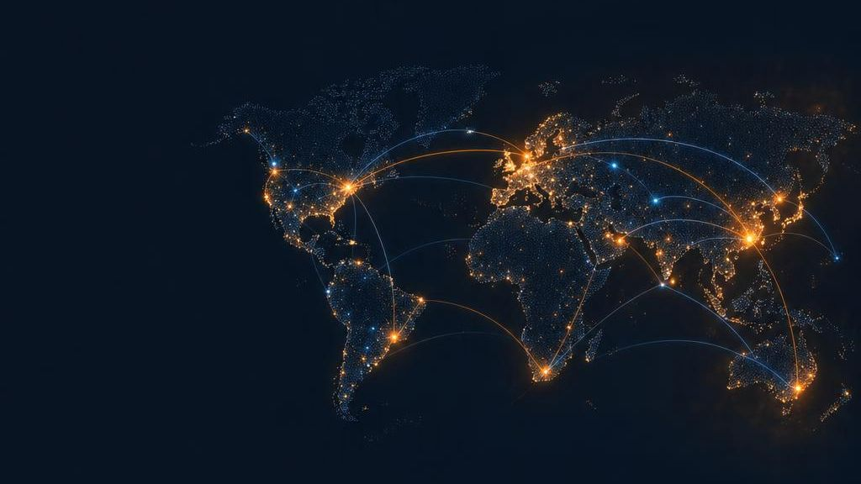

AMAZON
01 / 10
amazon
Search products, brands, categories
Cart (2)
Books
Electronics
Home
Fashion
Essentials
Recommended for you
Search
The Everything Store
Wireless earbuds
Bestselling novel
Desk lamp
Backpack
₹2,499
₹349
₹899
₹1,299
Building the easiest, most trusted and most scalable way to buy and sell anything online.
FREE delivery tomorrow on eligible orders
Wireless earbuds
₹2,499 ★4.5
Arrives tomorrow
Add to Cart
Investor Pitch | Founder Presentation
Notes:
Speaker script (≈40 sec):
“Sharks, I’m not here to ask you to invest in another online store. I’m offering you the opportunity to invest in the infrastructure that could power the future of shopping. Amazon is designed to become the easiest place on Earth to discover, compare, purchase and receive almost anything.”
Note: All financial and traction figures in this deck are illustrative pitch assumptions.

Slide 2
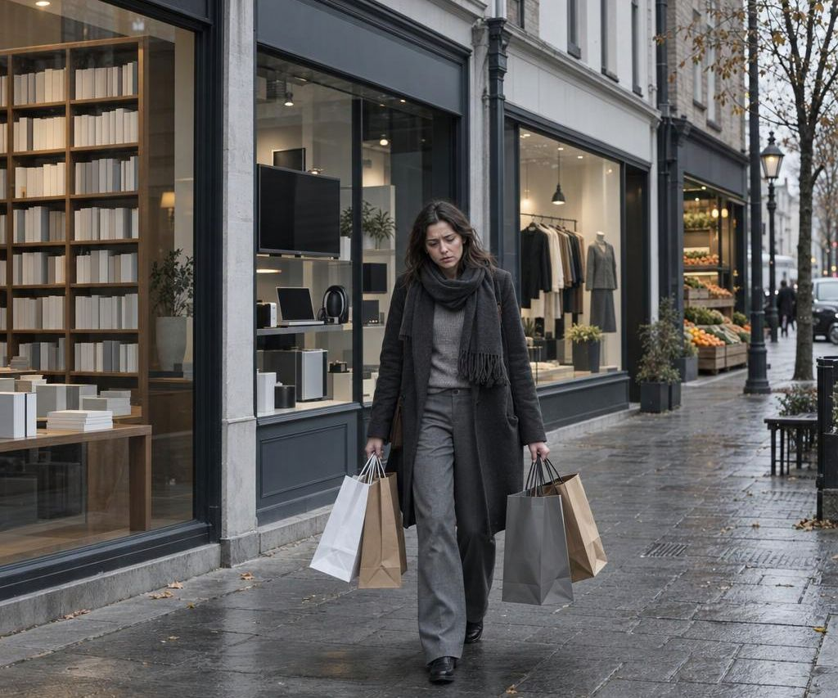
Shopping is still fragmented
02 / 10
Need
Search
Travel
Compare
Purchase
1
Limited selection
2
Higher time cost
Physical stores stock only what fits on their shelves.
Travel, queues and restricted hours turn one need into a trip.
3
Difficult comparison
4
Uncertain quality
3–4 stores → several hours → one incomplete journey
Customers visit several stores to compare products and prices.
Few reliable reviews, comparisons or seller transparency.
Illustrative customer journey, not measured research
Customers do not need more stores. They need one trusted destination.
Notes:
Speaker script (≈50 sec):
“Today, customers spend time moving between stores, searching for products and comparing prices without complete information. Traditional retailers are fundamentally limited by location, operating hours and shelf space. We see that limitation as an opportunity.”

Slide 3
One platform. Millions of possibilities.
03 / 10
Search. Compare. Trust. Purchase. Receive.
‹ Product
Vast selection
Trusted decisions
A digital catalogue is not limited by physical shelf space.
Ratings, reviews, product detail and secure payments reduce uncertainty.
Noise-cancelling headphones
★★★★☆ 4.4 (2,318)
Competitive pricing
₹4,999 -28%
Doorstep convenience
Delivery: Tomorrow, by 9 PM
Compare many products and sellers in one place.
Sold by: Verified Seller · 98% positive
Shop any time; receive at your chosen location.
Add to Cart
Buy Now
Discover
Search
Compare
Buy
Track
Receive
Review
Notes:
Speaker script (≈60 sec):
“Amazon turns a fragmented shopping process into one connected experience. Customers can discover a product, compare it, check trusted reviews, purchase securely and track the delivery without leaving the platform. We are reducing the distance between customer intention and customer action.”
UI/UX reasoning: the interface is designed around task completion, not decoration — find a product in seconds, compare alternatives easily, understand the final price, see when it will arrive, and complete the purchase with minimal friction.

Slide 4
We are not entering a category. We are digitizing commerce.
04 / 10
TAM
All retail spending that could eventually be influenced or completed digitally.
TAM
$500B
SAM
Customers with internet access, digital payments and delivery coverage.
SOM
Initial customer segments and categories we can realistically win.
SAM
$100B
Entry strategy: start where commerce is easiest to digitize
Standardized · Easy to catalogue · Easy to compare · Easy to ship · Bought repeatedly
SOM
Books
Electronics
Home & office
$1B
Personal care
Apparel
Everyday essentials
Illustrative sample model for presentation practice, not claims about Amazon’s historical market.
Notes:
Speaker script (≈45 sec):
“The opportunity is not limited to one product category. Commerce is one of the largest economic activities in the world, and more of it will move online as internet access, payments and delivery systems improve. We can begin with products that are easy to catalogue and ship, then expand into a much larger share of consumer spending.”
TAM $500B / SAM $100B / SOM $1B are illustrative figures only.

Slide 5
Multiple revenue streams. One scalable ecosystem.
05 / 10
1
Direct retail margin
Illustrative ₹1,000 order
Buy selected inventory and sell it directly.
More customers
2
Marketplace commission
Order value | ₹1,000
Seller commission (12%) | ₹120
Fulfilment fee | ₹60
Advertising | ₹30
Total Amazon revenue | ₹210
Delivery, support, payments | –₹140
Contribution | ₹70
A % of every successful third-party sale.
3
Fulfilment & logistics fees
Better experience
More sellers
Sellers pay us to store, pack, ship and handle returns.
Growth flywheel
4
Subscription revenue
Each turn adds scale
Recurring membership for faster delivery and benefits.
5
Advertising revenue
Sponsored placement for greater seller visibility.
Better prices
Greater selection
6
Technology services
Our infrastructure can later power other businesses.
Example model only, not actual Amazon financial data.
Notes:
Speaker script (≈65 sec):
“Our advantage is that we are not dependent on one revenue source. We can earn directly from product sales, indirectly through marketplace commissions, and repeatedly through fulfilment, advertising and subscriptions. As more transactions move through the platform, our infrastructure becomes more productive.”
Flywheel: More customers → More sellers → Greater selection → Better prices → Better experience → More customers.

Slide 6
Our advantage compounds with scale
06 / 10
Capability | Physical retailers | Small online stores | Amazon
Product selection | Limited | Moderate | Extensive
Price comparison | Difficult | Limited | Built in
Customer reviews | Rare | Inconsistent | Core feature
24/7 availability | No | Yes | Yes
Multi-seller marketplace | No | Rare | Yes
Fulfilment network | Local | Third-party | Integrated
Personalization | Minimal | Basic | Data-driven
Geographic scalability | Capital intensive | Moderate | High
Brand and scale
Fulfilment infrastructure
Behavioural data
Seller ecosystem
Customer trust
AMAZON
Network effect
Data advantage
Logistics advantage
Trust advantage
Switching costs
More sellers widen selection, attracting more customers.
Every interaction sharpens search and forecasting.
Order density lowers fulfilment cost per order.
Reliable reviews, refunds and delivery build habits.
Addresses, history and subscriptions lift retention.
Notes:
Speaker script (≈60 sec):
“A competitor can copy a website. It is much harder to copy millions of customer relationships, seller partnerships, product reviews, behavioural data and a coordinated fulfilment network. With every transaction, Amazon’s competitive position becomes stronger.”
Note: we do not claim there is no competition — our claim is that the moat deepens with scale.

Slide 7
Designed to convert intention into purchase
07 / 10
The customer always knows:
1 Home & search
2 Product details
3 Checkout & delivery
Where they are
Search “running shoes”
running shoes for men
Address
Payment
Confirm
running shoes women
What the product costs
running socks
Item
₹2,199
Recommended for you
Delivery
FREE
Trail running shoes
Taxes
Included
Why they can trust it
★★★★☆ 4.3 (1,204)
Order total
₹2,199
₹2,199 -35%
₹2,199
₹1,499
Delivery: Tomorrow · In stock
Verified seller · Easy returns
Arriving tomorrow, 9 AM–1 PM
When it will arrive
Add to Cart
₹899
₹3,499
Buy Now
Place your order
What to do next
Recently viewed · Trending
Specs · Reviews · Q&A
From discovery to purchase in under three minutes (design target, not a proven metric)
Accessible by design: 4.5:1 text contrast · keyboard access · alt text · clear focus states · ~44×44 px touch targets · helpful error messages
Notes:
Speaker script (≈70 sec):
“Our UI is not designed merely to display products. It is designed to reduce purchase anxiety. Search reduces effort, reviews create confidence, product comparison improves decisions, and clear delivery information makes the transaction predictable.”
Key components: persistent search-first navigation (autocomplete, spelling correction, category suggestions, voice and recent/trending searches); personalised discovery (frequently bought together, related, recently viewed); clear product-detail hierarchy; three-step checkout (Address → Payment → Confirmation) showing the full cost before payment.

Slide 8
Technology built for trust, speed and scale
08 / 10
1 Experience
Customer app
Website
Seller portal
Event-driven core
Order confirmed
2 Platform
Search
Catalogue
Cart
Checkout
Orders
Reviews
Payment completed
Inventory reserved
Package shipped
3 Intelligence
Recommendations
Fraud detection
Forecasting
Inventory placement
Delivery completed
Refund initiated
4 Operations
Warehouses
Sellers
Delivery partners
Customer service
Security & reliability
Encryption
Seller MFA
5 Data & infra
Databases
Search index
Cache
Analytics
Monitoring
Tokenized pay
Role-based access
Fraud detection
Backup & recovery
Monitoring
Audit logs
Independently scalable services: no single process depends on one large application.
Customer app / web
API gateway
Commerce services
Data platform
Seller & fulfilment
Notes:
Speaker script (≈75 sec):
“The platform is designed as a collection of scalable services rather than one monolithic application. Search, catalogue, checkout, payments and delivery can scale independently. This allows Amazon to support increasing traffic while maintaining speed, security and reliability.”
Data layer: transactional database (customers, orders, payments), search index, object storage for images and video, cache for hot products and sessions, analytics for forecasting and recommendations. Integrations: payment gateways, seller inventory systems, warehouse management, couriers, email/SMS/push.

Slide 9
Acquire trust first. Scale transactions second.
09 / 10
PHASE 1 · MONTHS 0–12
PHASE 2 · MONTHS 12–24
PHASE 3 · MONTHS 24–36
Establish trust
Expand the marketplace
Build the ecosystem
Launch in selected cities and high-demand categories
Onboard reliable sellers; secure payments and transparent returns
Build customer support
Add sellers, categories and seller advertising
Open regional fulfilment centres
Widen same-day and next-day coverage
Launch membership programme and private label
Sell fulfilment services to third-party sellers
Enter new geographic markets
50,000 active customers
250,000 active customers
1 million active customers
Illustrative unit-economics targets · Year 1 → Year 3
Average order value
Acquisition cost (CAC)
Orders / customer / yr
Repeat-purchase rate
On-time delivery
Contribution margin
₹1,200 → ₹1,500
₹500 → ₹300
3 → 8
25% → 55%
90% → 97%
2% → 8%
Dashboard also tracks: GMV · Revenue · Customer lifetime value · Return rate · Seller retention · Cart conversion
Notes:
Speaker script (≈70 sec):
“Our first objective is not aggressive monetization. It is customer trust. Once customers begin returning regularly, acquisition economics improve and more sellers join the platform. By year three, the goal is to create a repeat-purchase engine supported by marketplace fees, fulfilment income and advertising.”
All targets are illustrative pitch assumptions. Green marks improving metrics (CAC improves as it falls).

Slide 10
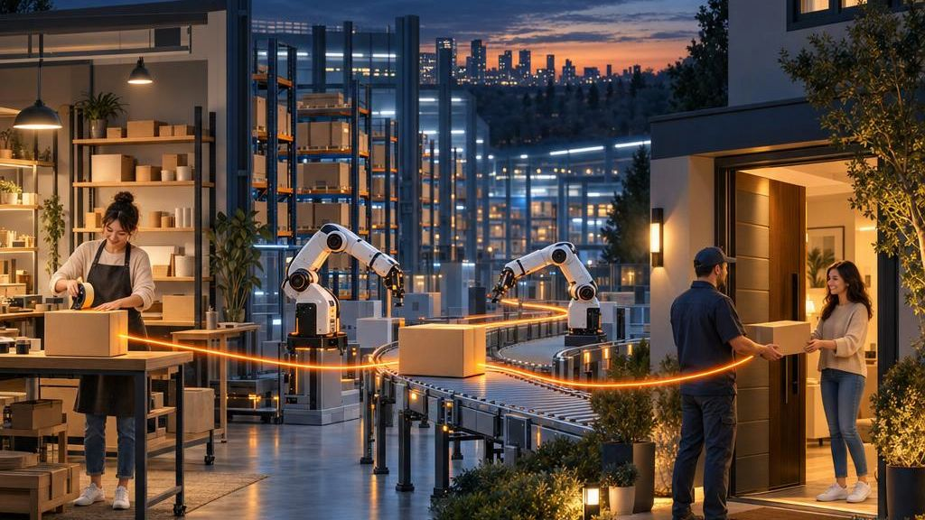
Invest in the future of commerce
10 / 10
₹10 crore
18-month objectives
100,000 active customers
for 10% equity
2,500 verified sellers
₹100 crore post-money valuation · illustrative ask
10 major cities
30% Technology & product
95% on-time delivery
A strong repeat-purchase base
Seller → Fulfilment → Customer
30% Fulfilment & logistics
Positive contribution in mature zones
Use of funds
20% Customer acquisition
Key risk | Mitigation
Logistics costs outpace revenue | Launch by city and delivery zone; add capacity in stages
Expensive customer acquisition | Prioritise contribution margin over vanity growth
Low-quality sellers erode trust | Verify sellers; monitor defect and cancellation rates
Returns and fraud cut margins | Category-specific return policies and fraud checks
Rapid growth causes service failures | Expand fulfilment capacity in planned stages
10% Seller onboarding
10% Service & compliance
Who wants to build the future of commerce with us?
Notes:
Speaker script (≈60 sec):
“Sharks, you are not investing in a website that sells products.” [PAUSE]
(Slower, confident; hold eye contact during the ask)
“You are investing in a marketplace that becomes stronger with every customer, every seller and every transaction. Traditional businesses build more stores. We are building the platform that can bring every store to every customer. The future of shopping is not another physical location. The future of shopping is Amazon.”
The ₹10 crore for 10% (₹100 crore post-money) ask is an illustrative sample — adjust to your scenario.

